Slide 1
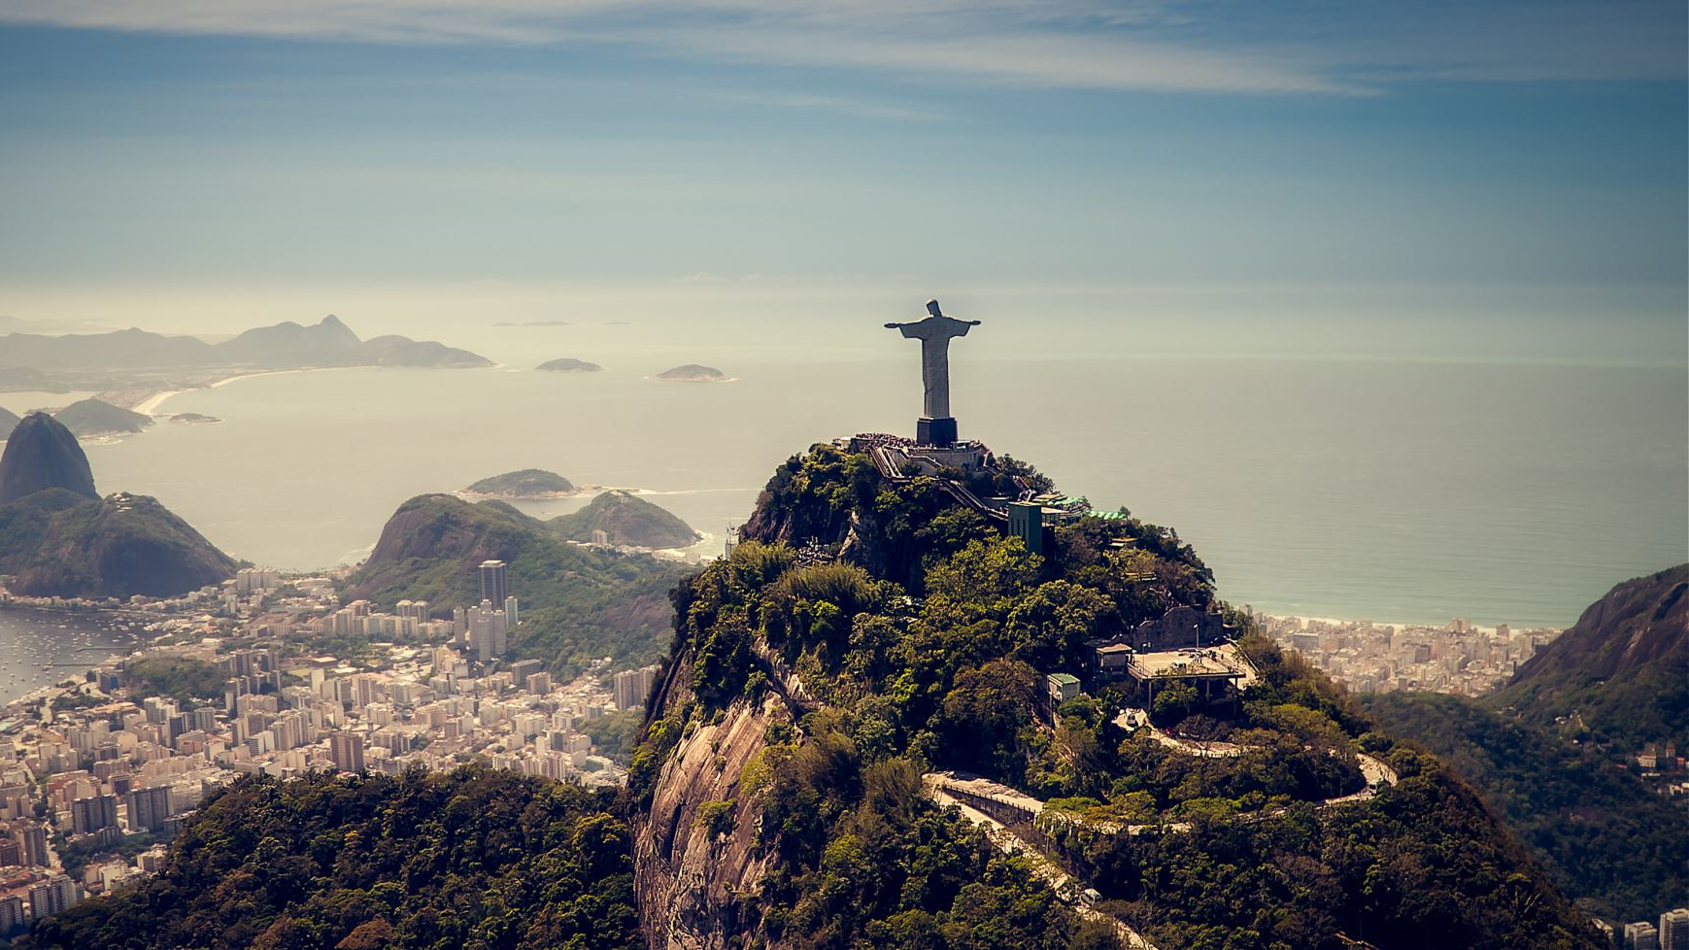
The trending venues in Lisbon and Rio de Janeiro.
Case study, application of clustering to find similarities between trending places
Alexandre Gomes

Slide 2
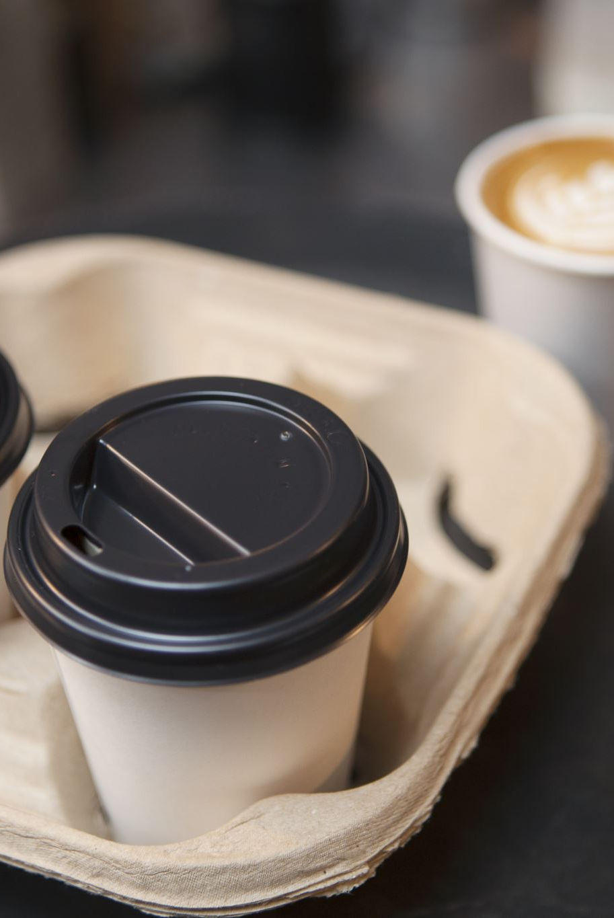
Introduction
Going to holidays and choose places to stay and enjoy might be a challenge. Sometimes places were made for tourists and we can't enjoy local culture. and some trending places are too fancy and expensive, at the end have poor quality, as many restaurants we can see that food isn't fresh and all customers are foreign people. Maybe all tourists were fooled

Slide 3

Data and Source
We used data from Foursquare in order to collect some characteristics from each spot.
Such as categories, number of reviews, rating, average cost, name and location.

Slide 4
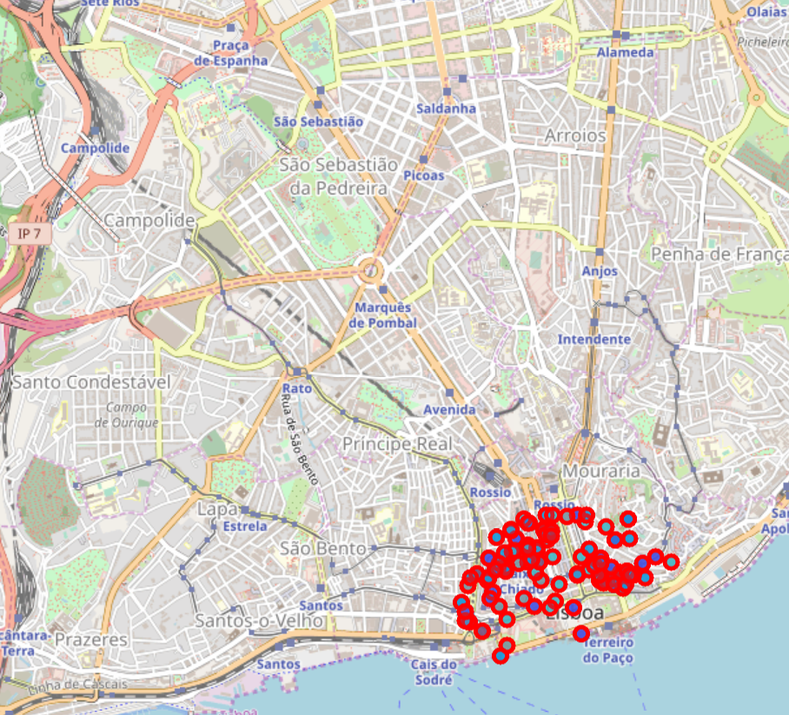
Top 100 venues in LISBOM

Slide 5
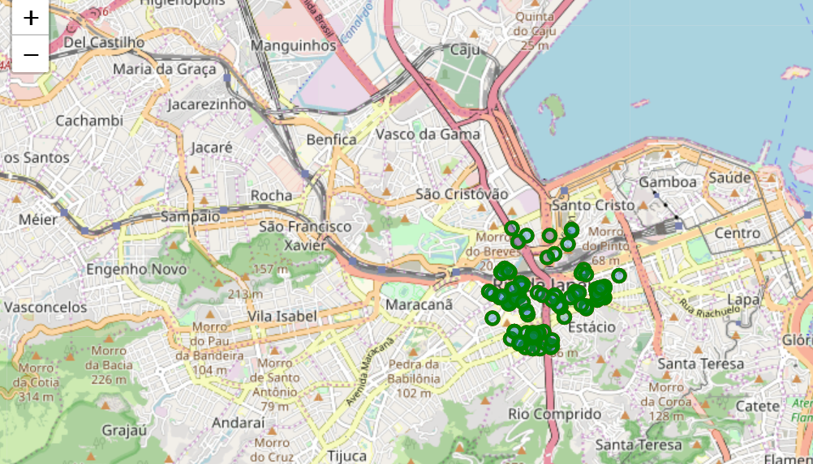
Top 100 Venues in Rio de Janeiro

Slide 6
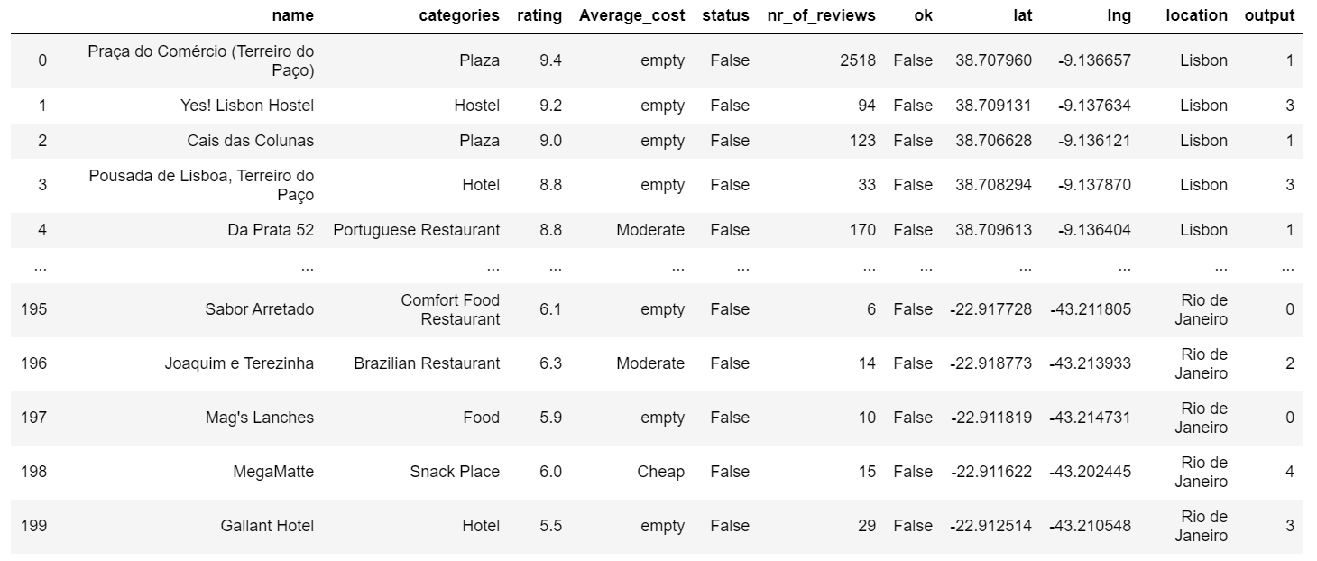
Table Visualization

Slide 7
Now we applied non supervised technique called K-mean, with k =5
Let’s check the result using package Folium

Slide 8
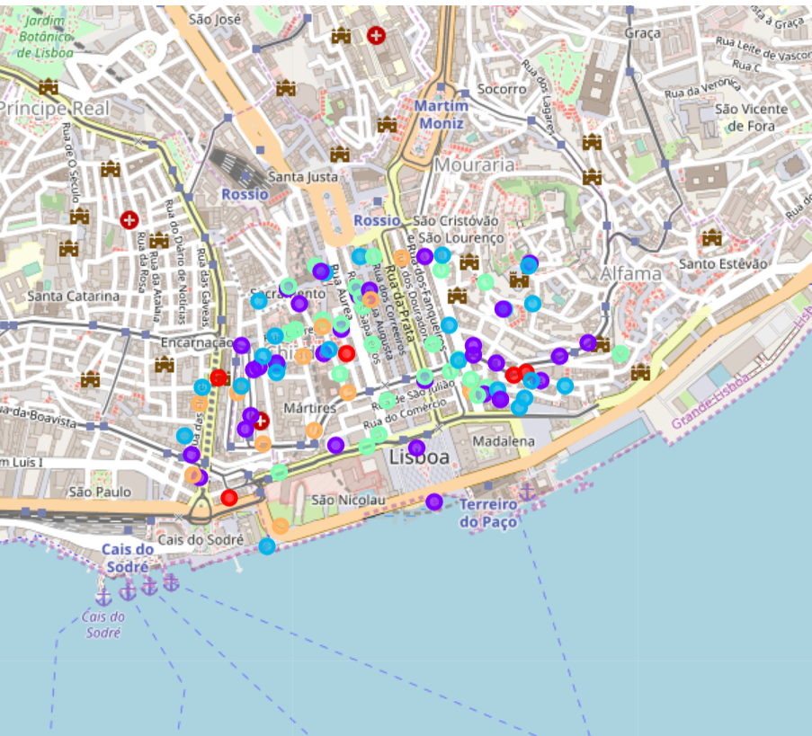
Each location and its cluster - Lisbon

Slide 9
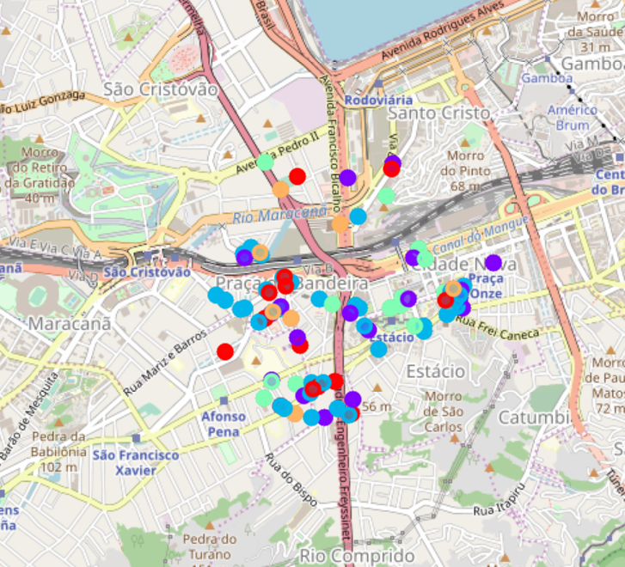
Each location and its cluster – Rio de Janeiro

Slide 10
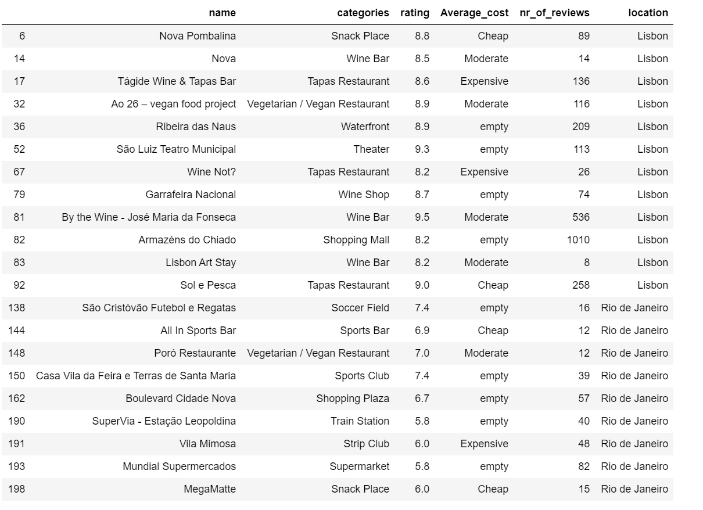
An example:5th cluster and its characteristics Categories: {entertainment cluster: (majority ) - bars, pubs and clubs} Price between moderate and Expensive

Slide 11
Conclusion
If we are interested in looking for a moment to entertainmet: we can use 5th cluster and search for a places that are similar in Lisbon and Rio.
See an example: if you love nova pombalina when you stay in Lisbon, perhaps when you go to Rio de Janeiro you might like to know Megamatte. It’s a nice cluster so look at when you are looking for entertainment.
If you are interested in other places like hotels you can seen in other cluster. And so on.

